Slide 1
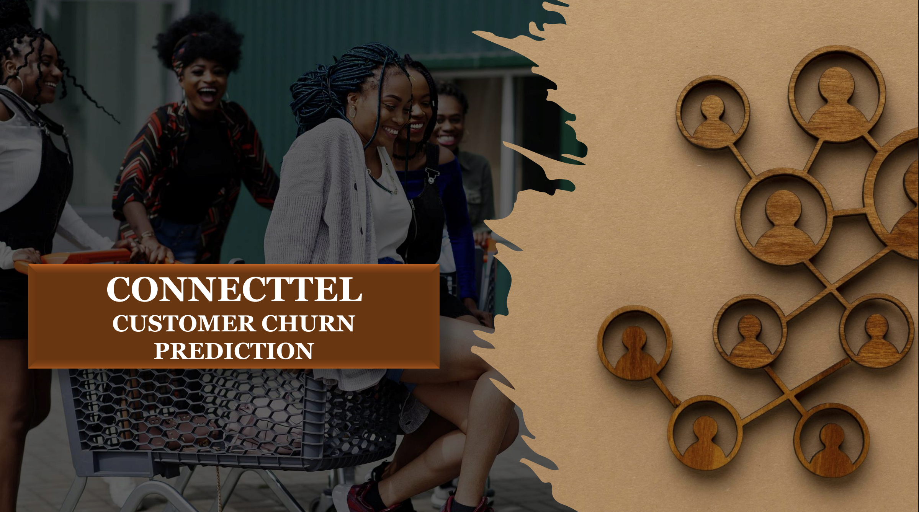

Slide 2
Churn Dataset prediction
By Faith Esohe Ejele

Slide 3
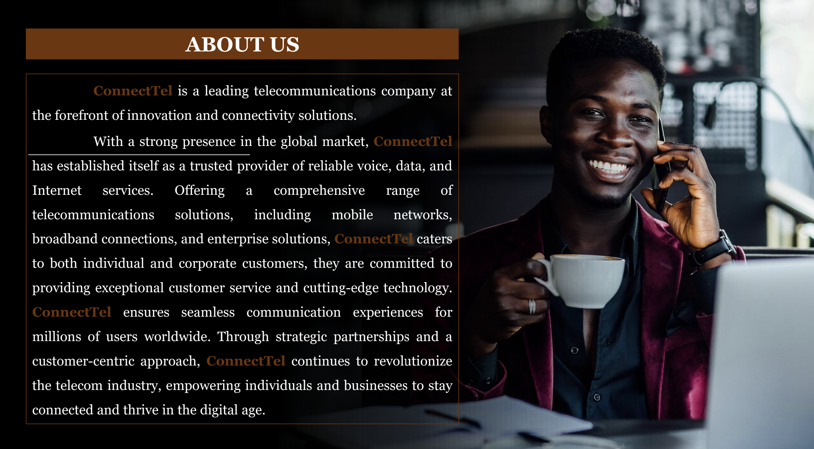

Slide 4
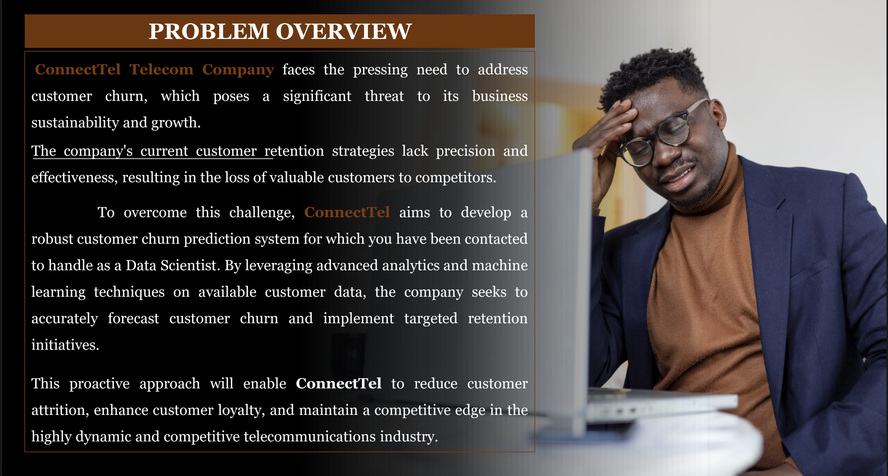

Slide 5
Problem Definition
Customer churn is the process where customers stop using a company's products or services over a specific period. Connectel, a subscription-based model is set to retain customers and be outstanding in the competitive industries.
Retaining customers is essential for long-term growth and profitability. Elevated churn rates can signal customer dissatisfaction or the availability of more appealing alternatives in the market.

Slide 6
Business Problem-Connectel
The company is facing a significant churn rate, affecting both revenue and long-term customer loyalty. Identifying the key factors driving churn and predicting at-risk customers will empower the company to develop targeted strategies for customer retention.

Slide 7
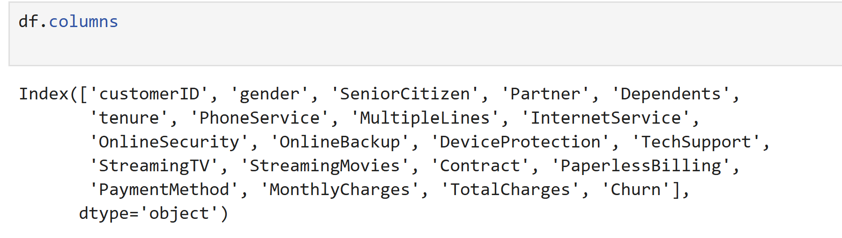
Features of Churn Dataset

Slide 8
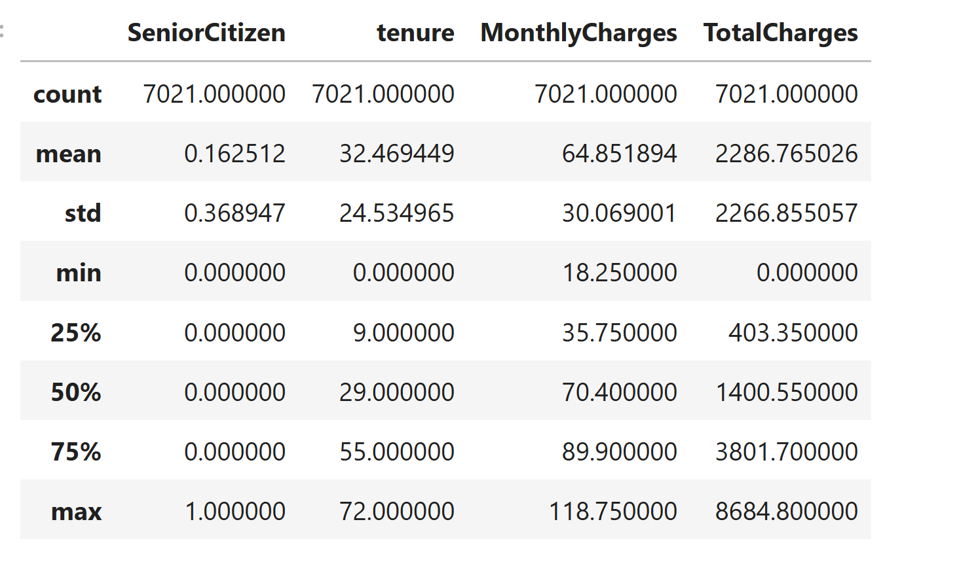
Numerical Statistics

Slide 9
Data Visualization

Slide 10
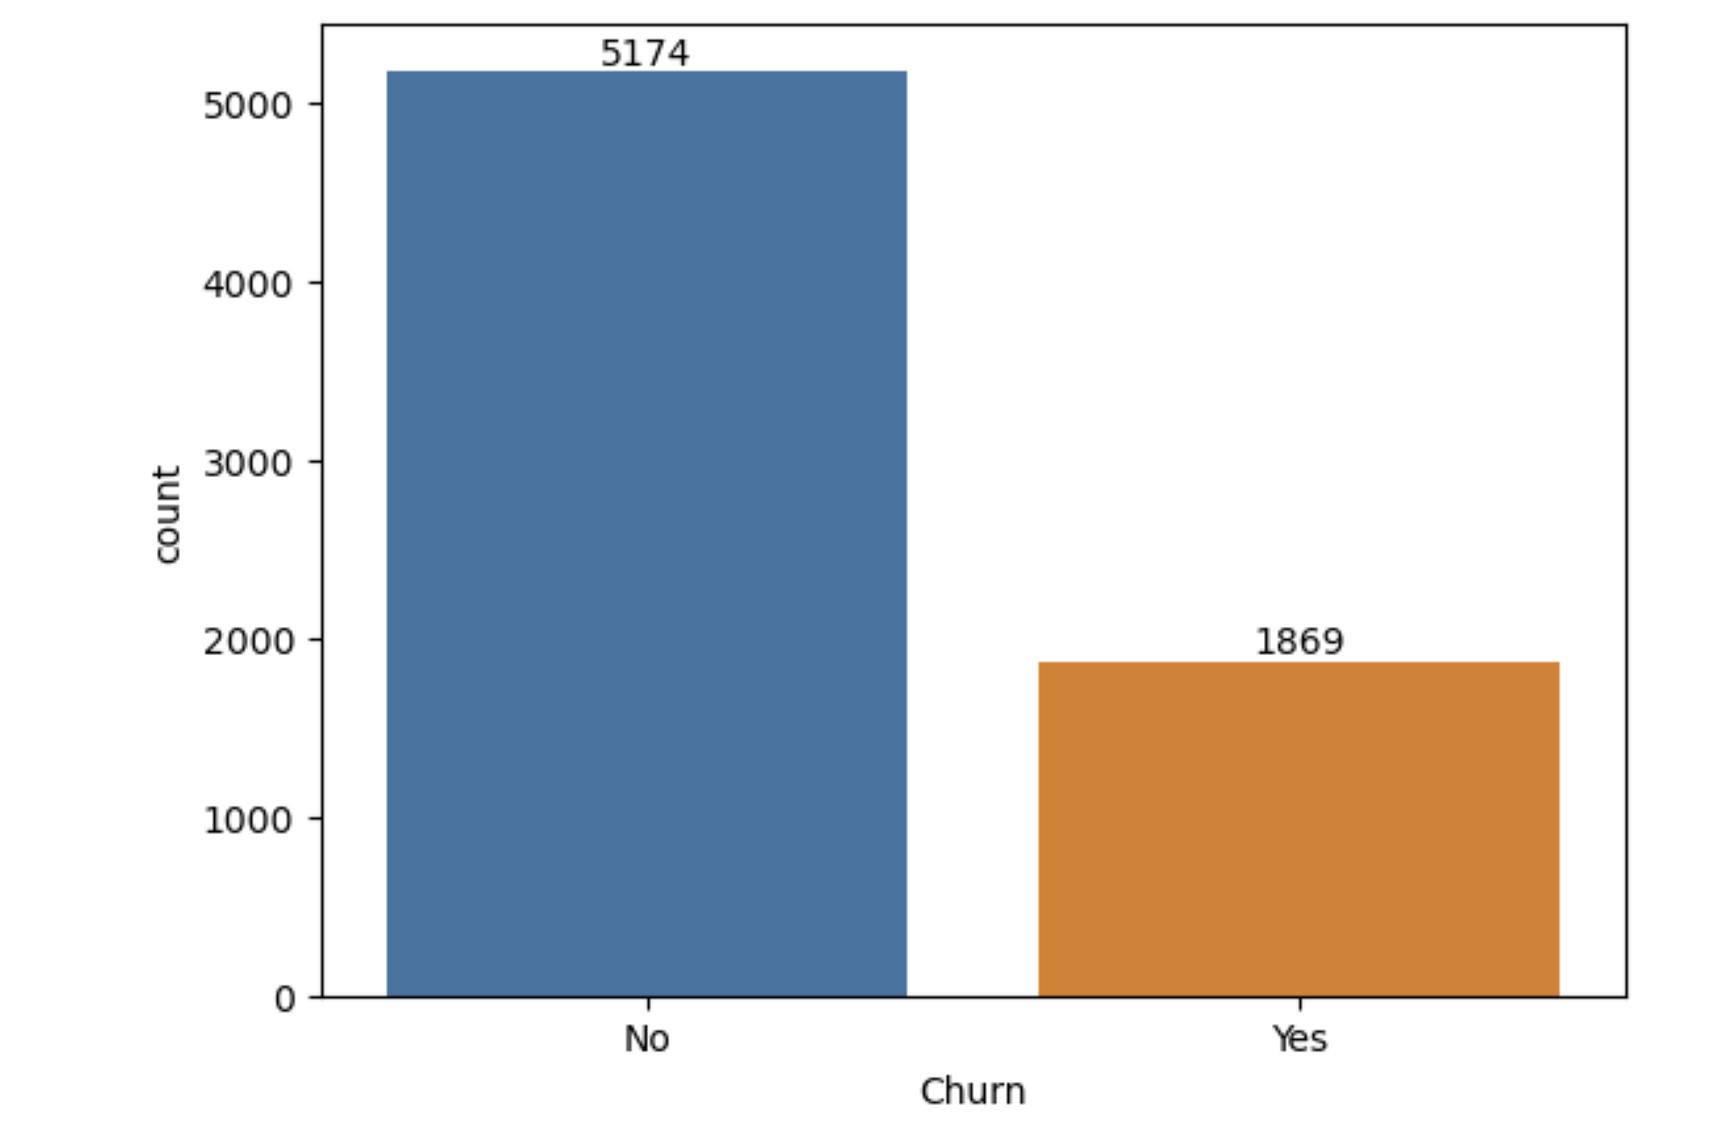
Total Number of Churn

Slide 11
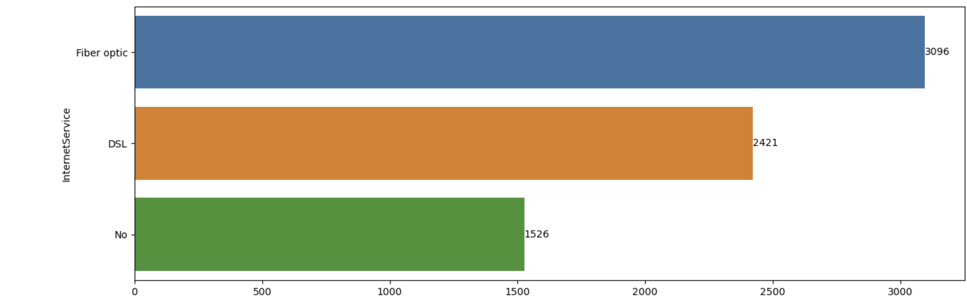
Internet Service

Slide 12
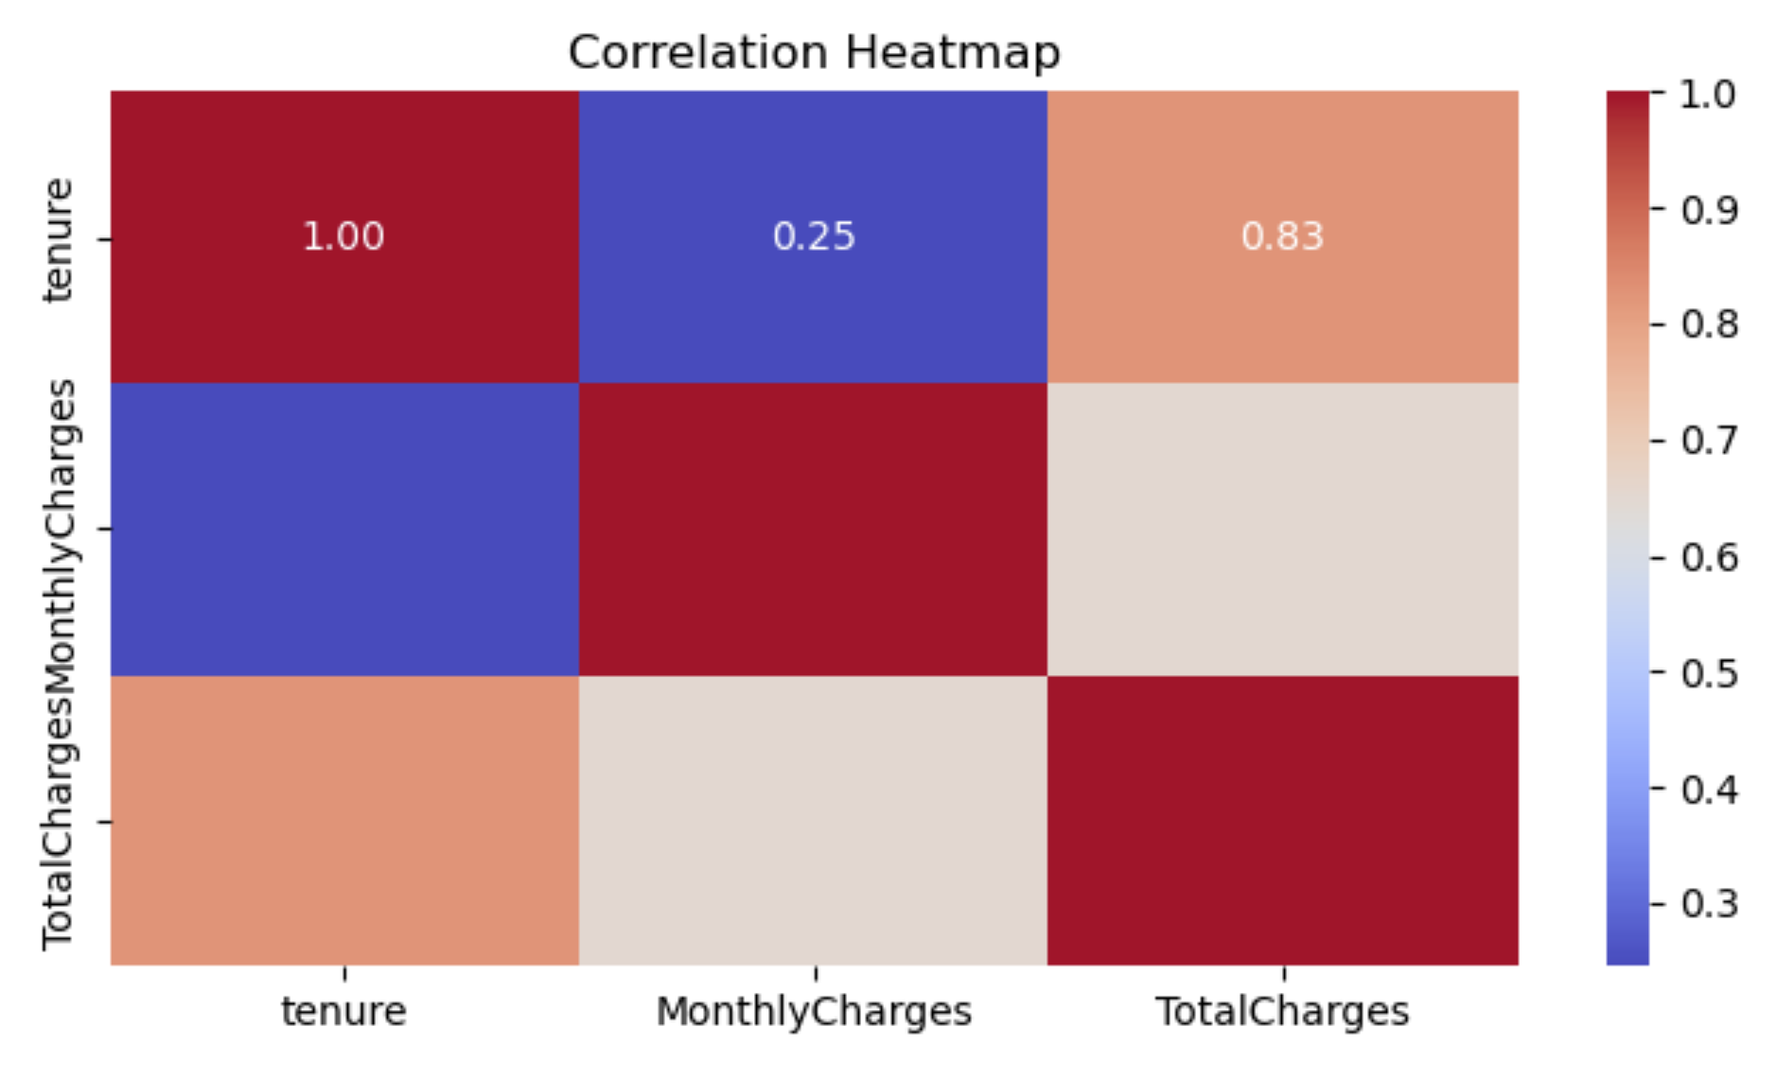

Slide 13
# Who is likely to churn?
Customers with shorter tenure are more likely to Churn than those with longer tenure. Payment method – Electronic check payment may indicate higher Churn Monthly Charges- Higher charges in the internet service may lead customers to migrate to competitors.

Slide 14
What are the most significant factors contributing to churn?
The most important factor contributing to the Customer churn is the type of contract the customer engagement, the month-to-month contract are more likely to churn than annual contracts. Customer experience is another factor that can have great impact on the customers, service issues with internet such as low internet speed, network problem and reduced service will increase the likelihood of high Churn rates. High Pricing- High pricing of a contract will lead to a high Churn rates as customers will migrate to other service providing internet service at a good rate. Competition- Customers tend to move to companies with better offer rate and good internet service, this will lead to a high Churn rate.

Slide 15
How can the company proactively engage at-risk customers to reduce churn?
Company can pro-actively engage at-risk customer to reduce churn by providing rewards, discounts or free trials for a period of time before customer engages the service.Company can encourage customer for a down grade instead on complete cancellation that will increase the rate of churn. For high valued customers, measures can be placed with the account managers to closely manage such accounts.Conduct surveys to measure customer feedback, this will give knowledge of the pain point of the customer.Regular emails and text messages to check with the performance and engagement of customers on social media

Slide 16
What customer segments are most vulnerable to churn?
The customer segments most at risk of churn include new users, low-engagement customers, single users, and those experiencing billing issues. By proactively identifying these groups and implementing tailored retention strategies, businesses can minimize churn and enhance long-term customer loyalty.

Slide 17
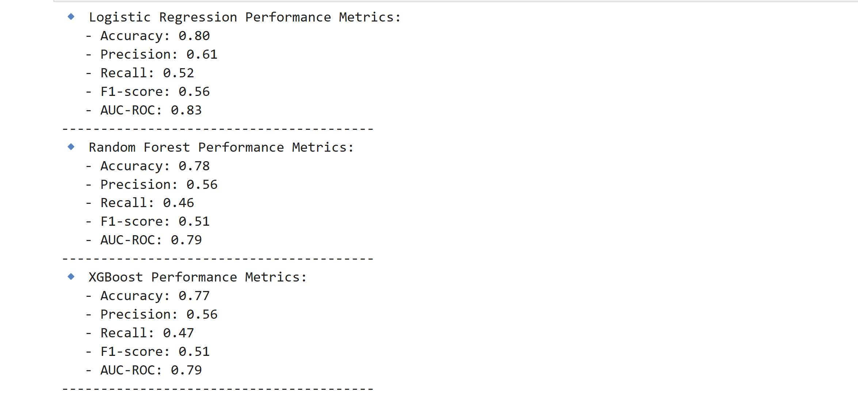

Slide 18
Summary Insights
Firstly, Insights about the data collected regarding ConnectTel
:The CustomerID was dropped as it will not be needed for the Analysis# Total number of Rows and Columns was identified
No missing data in the dataset
TotalCharges column had missing data which was replaced with '0’
Datatype for 'TotalCharges' column was changed from 'object' to 'float

Slide 19
Recommendation
To reduce Churn;
Connectel should offer loyalty program to customer that will attract them to engage with the internet service.
Encourage long term contract by giving discount to loyal customer to discourage them from going to subscribe to month-month subscription.
Identify high risk customers and offer packages that will make them engage with the service.

Slide 20
Conclusion
Using the Prediction Model to fine-tune the business to encourage customers to engage in the business.
Machine learning to predict, will reduce the loss of customers and increase the engagement over-time.
Using Machine model will increase customer retention rate.

Slide 21
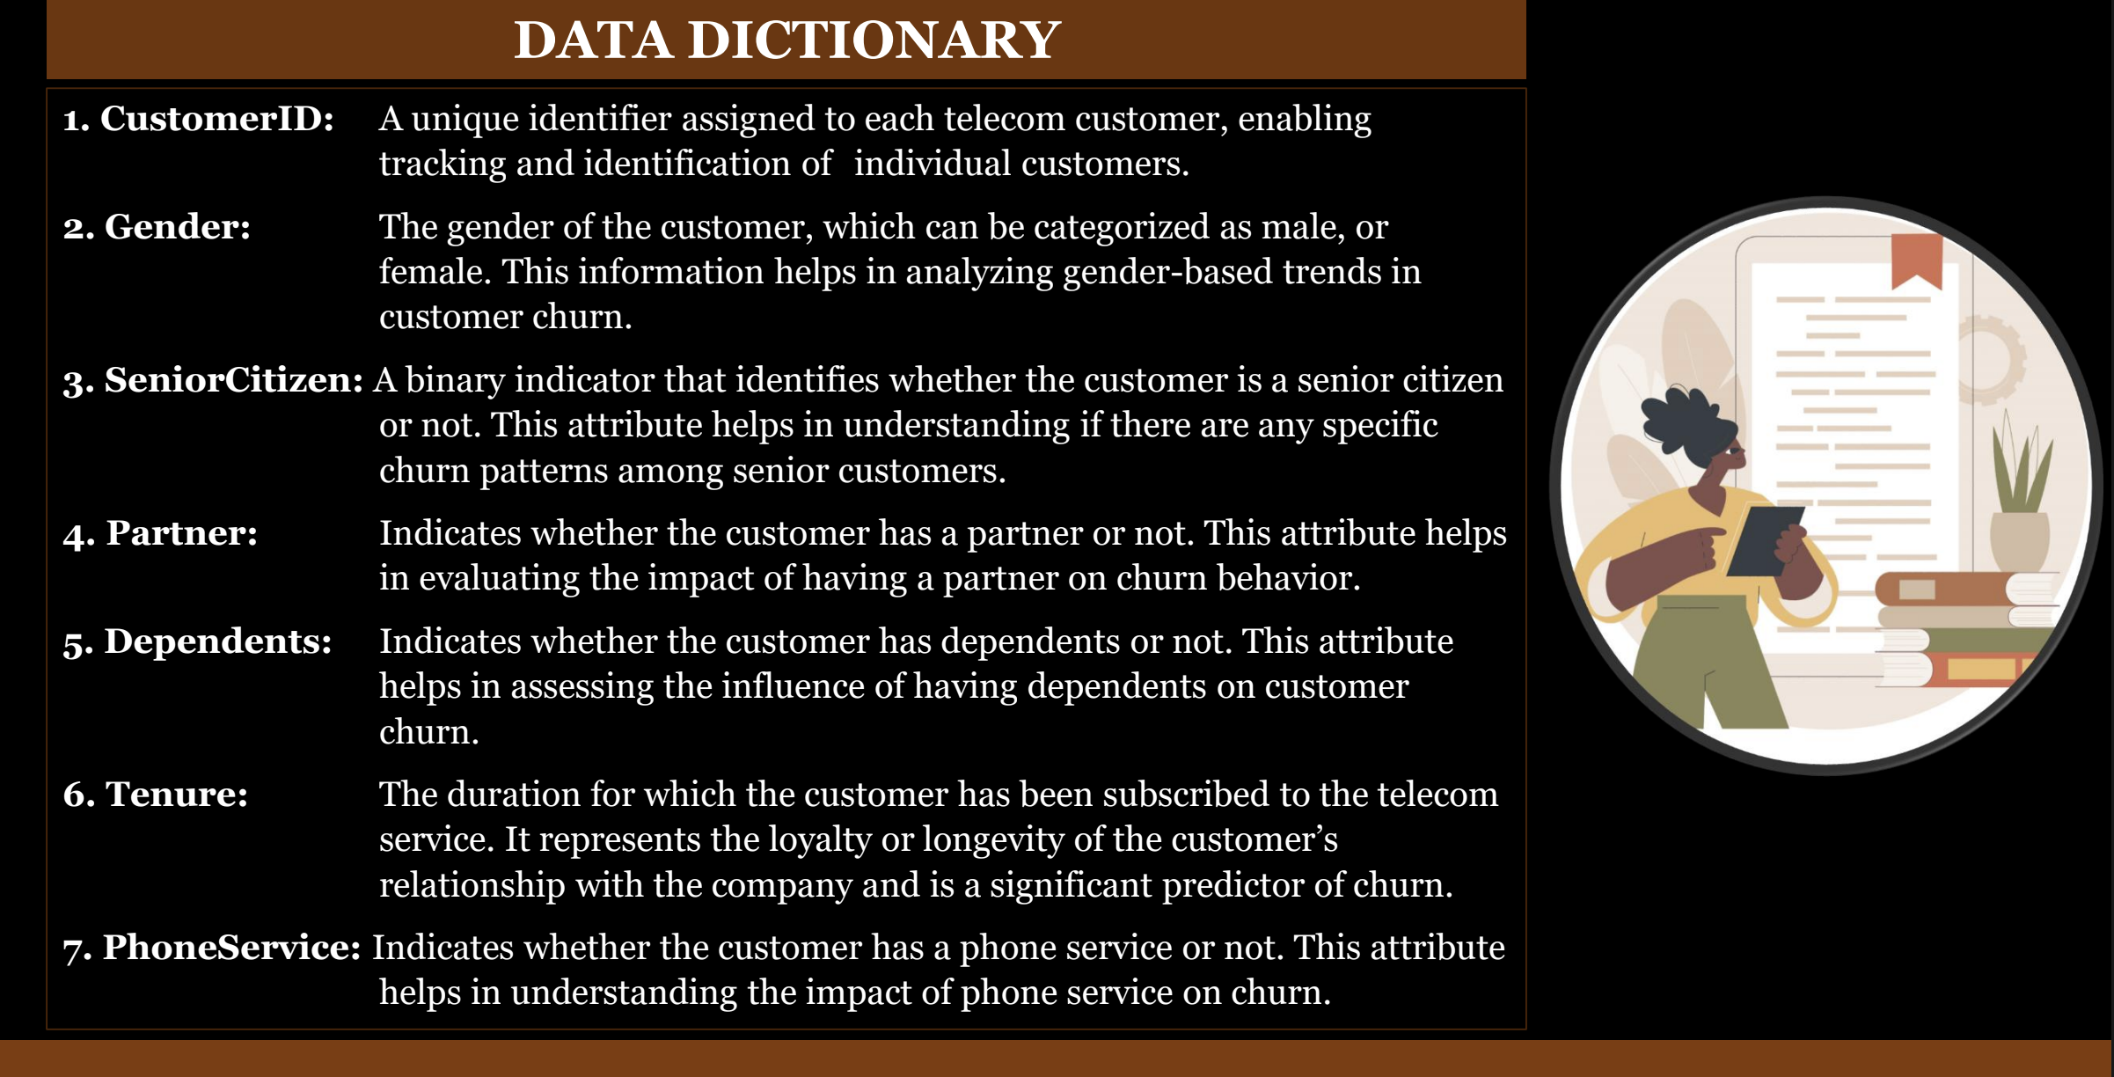

Slide 22
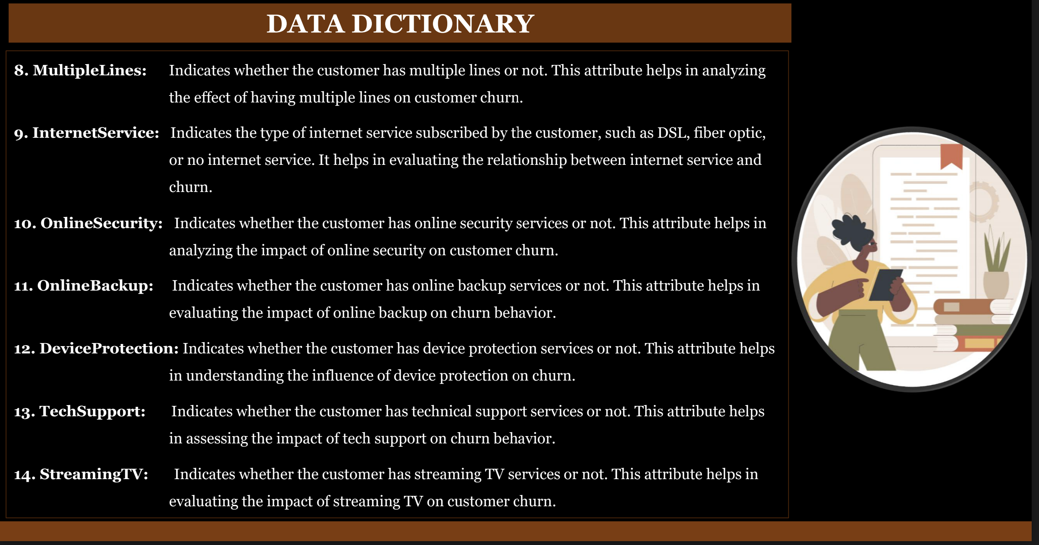

Slide 23
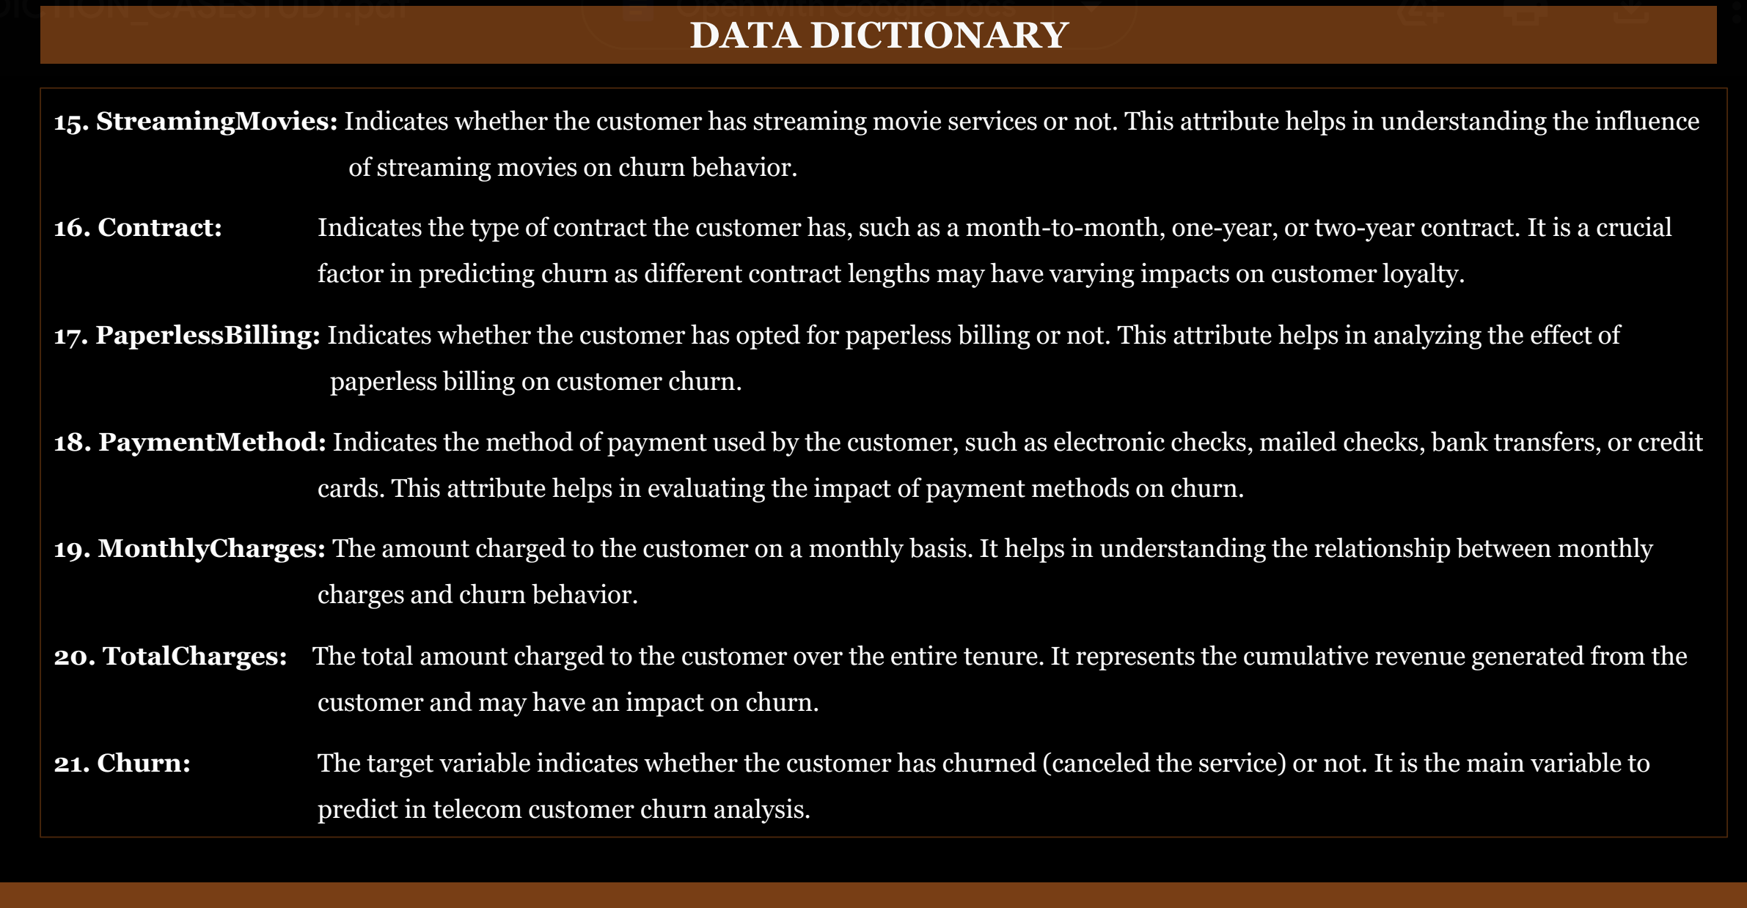

Slide 24
Thank you

